Slide 1
What’s new in C# and visual studio 10.12.2018
Jarred Capellman

Slide 2
Traditional Subsets
SPAN and slice C# 7.2
var bytes = File.ReadAllBytes(“Camaro.jpg”);
var result = Analyze(bytes.Take(1000));
public bool Analyze(byte[] bytes) {
// …
}
Span<byte> bytes = File.ReadAllBytes(“Camaro.jpg”);
var result = Analyze(bytes.Slice(1000));
public bool Analyze(byte[] bytes) {
// …
}

Slide 3
Span continued
var carName = “Camaro’s are great, high performing cars.”;
// Allocates memory of the substring
string subsetOfString = carName.Substring(startIndex: 2, length: 5);
// No allocations
ReadOnlySpan<char> subsetOfString = carName.AsSpan().Slice(start: 2, length: 5);

Slide 4
Stackalloc (< 7.2)
Stackalloc (7.2)
Span<byte> someBytes;
unsafe
{
byte * temp = stackalloc byte[length];
someBytes = new Span<byte>(temp, length);
}
Span<byte> bytes = stackalloc byte[length];
Notes:
Perfect for small collections without wanting to do allocations on the heap

Slide 5
C# 8 NEW FEATURES

Slide 6
Switch/case “2.0”
Switch/case “3.0”
switch (car) {
case Camaro c:
return c.IsNA;
case Mustang m:
return m.IsShelby;
}
return car switch {
Camaro c => c.IsNA,
Mustang m => m.IsShelby;
};

Slide 7
INDEX AND Range expressions
var lastElement = someString[someString.Length – 1];
var lastElement = someString[^1];
var lastElement = someString.Substring(1, someString.Length - 1);
var lastElement = someString.Substring(1..^1);

Slide 8
POCOS 1.0
POCOS 2.0 aka Records
public class Camaro : BaseCar {
public bool HasNA { get; }
public bool IsConvertible { get; }
public Camaro (bool hasNA, bool isConvertible) {
HasNA = hasNA;
IsConvertible = isConvertible;
}
// Equals, GetHashCode etc..
}
public class Camaro(bool hasNA, bool isConvertible);

Slide 9
Updated frameworks and tooling

Slide 10
.NET Core windows compatibility pack
20,000+ APIs now available (System.Drawing, System.Management etc.)
if (RuntimeInformation.IsOSPlatform(OSPlatform.Windows)) {
using (var key = Registry.CurrentUser.OpenSubKey(@"Software\Awesomeness")) {
// …
}
}

Slide 11
.NET Core 3.0 (2019)
Self-contained EXE on Windows (no dependencies on .NET Core or .NET Framework
Non-UWP applications (WPF and WinForms) can now take advantage of the newer project structure
Faster iterations and take advantage of .NET Core optimizations over .NET Framework

Slide 12
Razor pages
Index.cshtml
Index.cshtml.cs
@page
@model IndexModel
@inject IStorageDatabase Database;
@inject IQueue Queue;
<h2>Server Status</h2>
<h3>@Database.Name (Database) Status</h3>
<p>Is Online: @Database.IsOnline()</p>
<h3>@Queue.Name (Queue) Status</h3>
<p>Is Online: @Queue.IsOnline()</p>
public class IndexModel : PageModel
{
public void OnGet()
{
// Do stuff
}
}

Slide 13
ML.NET
Open source (on GitHub) supports TensorFlow, CNTK, Scikit-Learn, CoreML (any ONNX 1.2 models)
var pipeline = new LearningPipeline
{
new TextLoader(trainingFileName).CreateFrom<T>(separator: ','),
new ColumnConcatenator("Features", "Features"),
new FastTreeRegressor()
};
model = pipeline.Train<T, TK>();
await model.WriteAsync(ModelName);

Slide 14
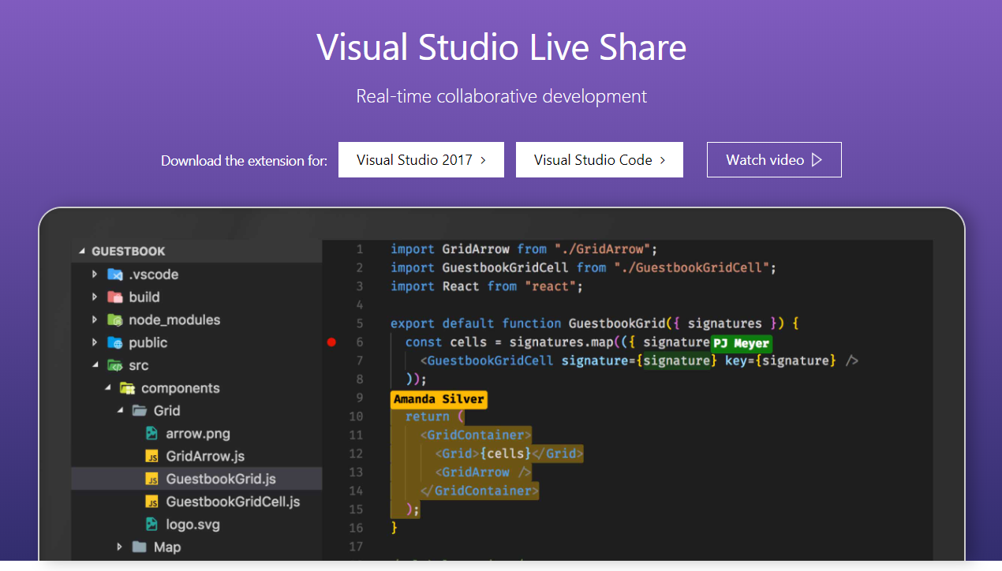
Visual studio live share

Slide 15
Questions?

Slide 16
Resources
PowerPoint and Sample Source Code
https://github.com/jcapellman/Presentations

